Slide 1
K-Means Clustering for Customer Segmentation Analysis
Big Data Technology in Business
Ariana Arellano, Roy Avalos, Issac Chen, Norberto Limon

Slide 2

Agenda
Introduction
Research Question
Objective
Literature Review
Data Collection & Methodology
Processing
Normalization
Methodology
Analysis & Results
Validation,
Clustering Analysis,
Segmentation
Conclusion

Slide 3
Introduction
Research Question, Objective, Literature Review

Slide 4

Introduction
Research Question
How can we use K-Means Clustering, based on purchase history for customer segmentation, to enhance personalized marketing strategies and improve customer retention?
Objective
To develop a classification model for marketing segmentation.
Goal is to extract insights that inform promotional strategies through the use of K-Means cluster analysis on a dataset sample by an anonymous Online Retailer

Slide 5
Introduction
Literature:
Punj, G., & Stewart, D. J. (1983). Cluster Analysis in Marketing Research: Review and Suggestions for Application. Journal of Marketing Research, 20(2), 134 https://doi.org/10.2307/3151680
Introduced the two-stage cluster analysis methodology
Kaur, S., & Sarabjeet (2021) Customer Segmentation Using Clustering Algorithm. IEEE International Conference on Technological Advancements and Innovations (ICTAI) Publication | IEEE Xplore. https://ieeexplore.ieee.org/document/9673169
two-step optimization (FSGA-FCEN); customer segmentation use case, sklearn
Wu, Z., Jin, L., Zhao, J., Jing, L., & Chen, L. (2022). Research on Segmenting E-Commerce Customer through an Improved K-Medoids Clustering Algorithm. Computational Intelligence and Neuroscience, 2022, 1–10. https://doi.org/10.1155/2022/9930613
K-Medoid for noise reduction; RFM & CH Index alternative-value method
Notes:
1. The two-step methodology employed here has a long history, continues to be used today and has since inspired other approaches
2. One such method was FSGA-FCEN, this study used sklearn for a similar approach to K-Means Clustering for Customer Segmentation
3. We found that K-medoids provided certain benefits in situations with a lot of noise but for our use case we were not suffering from that problem. We decided to go with K-Means because it is a much longer research history and continues to have wide implications in many industries. For our K-value we decided to go with another approach that my colleagues will be discussing in just a few moments.

Slide 6
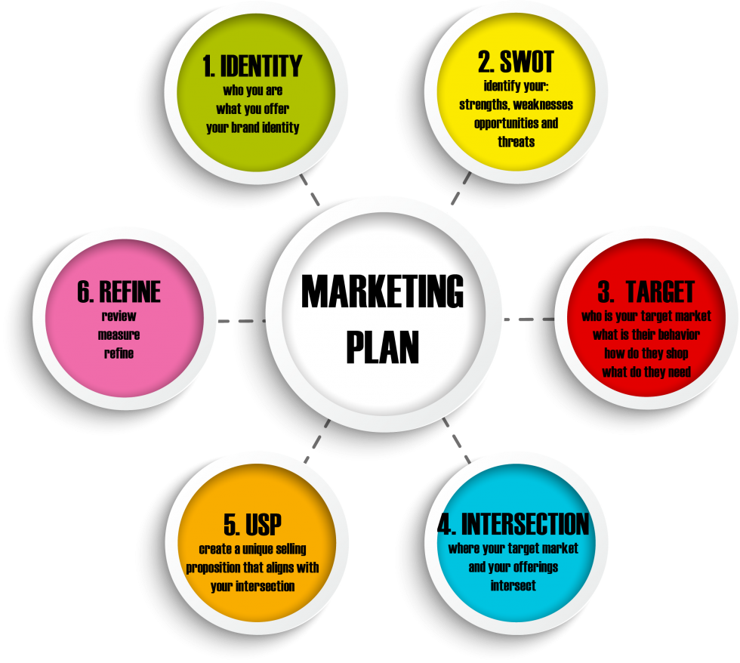
Introduction
Marketing Plans
Strategic roadmap that businesses use to organize, execute, and track their marketing strategy over a given period. Marketing plans can include different marketing strategies for various marketing teams across a company.
The purpose of a marketing plan is to write down strategies in an organized manner. This will help keep you on track and measure the success of your campaigns.
Notes:
Writing a marketing plan will help you think of each campaign‘s mission, buyer personas, budget, tactics, and deliverables. With all this information in one place, you’ll have an easier time staying on track with a campaign. You’ll also discover what works and what doesn't. Thus, measuring the success of your strategy.

Slide 7
Data Collection and Planned Methodology
Processing, Normalization, Methodology

Slide 8
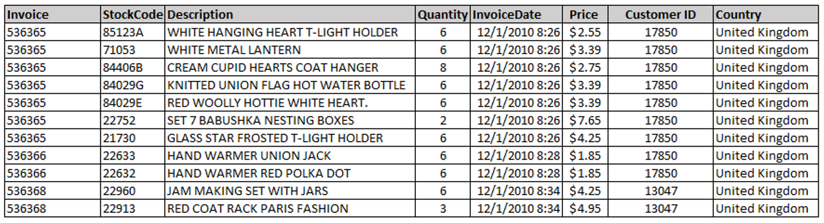
Data Collection and Planned Methodology
Dataset
Online Retail II dataset was pulled from UC Irvine Machine Learning Repository. UK-Based online retail company.
1,067,371 Instances (Customers’ Purchasing Transactions)
8 Variables (Multivariate, Sequential, Time-Series, Text)

Slide 9
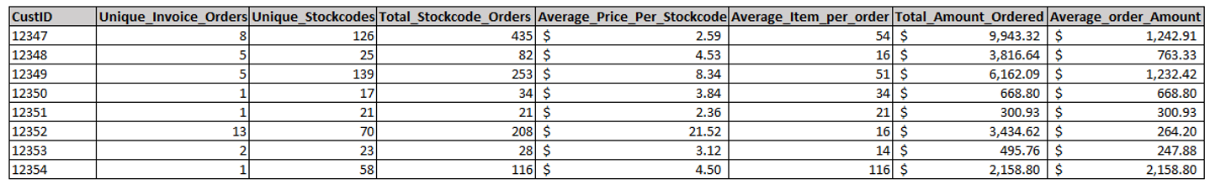
Data Collection and Planned Methodology
Dataset
Aggregate the Data - Customer ID.
Transform New Variables - Extrapolate Purchasing Details
Remove missing values - Missing Customer IDs
New Transformed Data Set - 5800 records (Customer ID Purchasing Details)

Slide 10
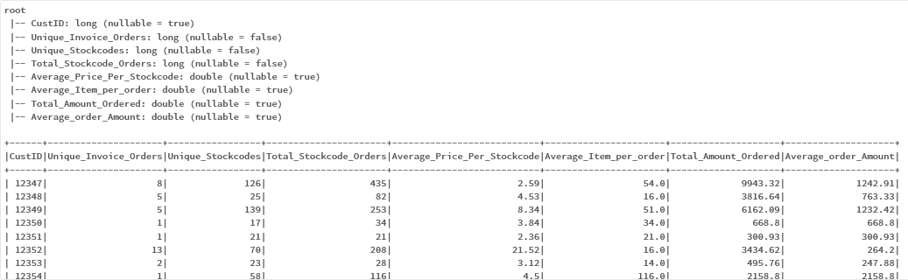
Data Collection and Planned Methodology
Dataset

Slide 11
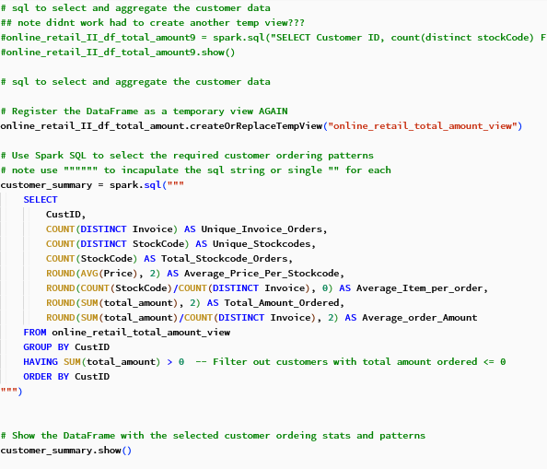
Data Collection and Planned Methodology
Data Processing / Aggregation
Unique Invoice Orders
Unique Stockcodes
Total Stockcode Orders
Average Price Per Stockcode
Average Item Per Order
Total Amount Ordered
Average Order Amount

Slide 12
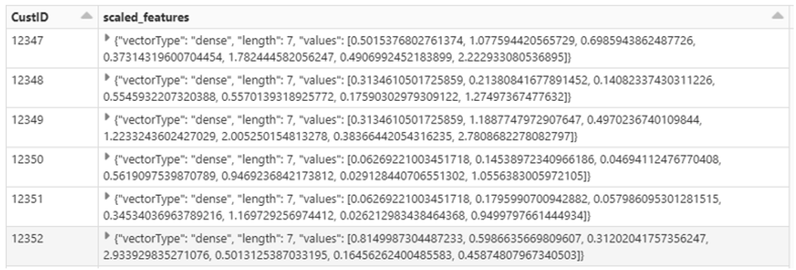
Data Collection and Planned Methodology
Data Processing / Aggregation
Normalized the Data - Minimize Outliers ( StandardScaler pyspark)
Scaled Feature - Used for K-means

Slide 13
Data Collection and Planned Methodology
Methodology
Elbow Method - Used to determine the optimal number of Ks (Cluster)
Groups cluster with similar data point
K-Means - Unsupervised Machine Learning
Used to segment Customers based on purchasing patterns

Slide 14
Analysis & Results
Validation, Clustering Analysis, Segmentation

Slide 15
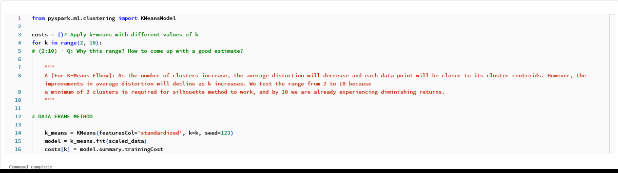
Validation Results
Elbow Method

Slide 16
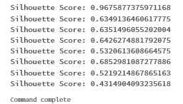
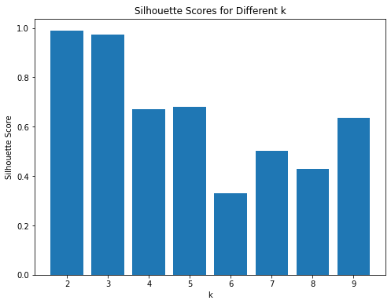
Validation Results
Data Validation
We used an alternative approach to obtain our K-value called the Silhouette Method.
Calculates a score for your data with candidate k values
After the initial drop, common practice is to select the next clear local minimum. In our case:
Silhouette Score: 0.685298108
K=7
Notes:
This approach is more resource intensive than our primary so is not used as our primary method, but can be another reliable way of obtaining K and in our case is used as a validation method for the Elbow Method.

Slide 17
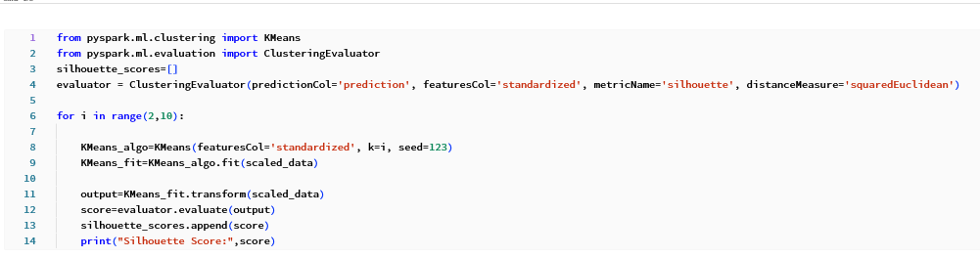
Validation Results
Silhouette Method

Slide 18
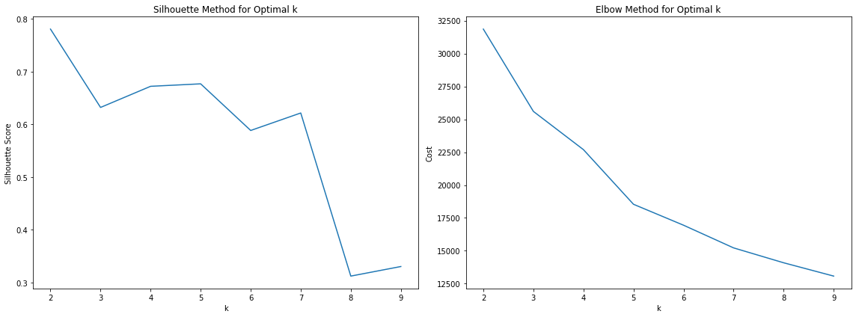
Validation Results
Both the silhouette method and the elbow method confirm that the optimal k value equals 7, with 5 as a potential secondary option

Slide 19
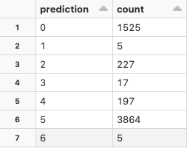
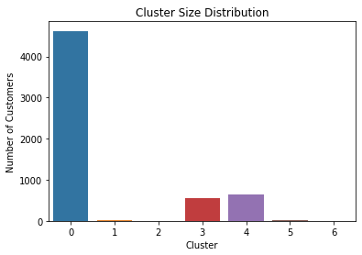
K-Means Cluster Results
Using k=7 from the validation methods we have grouped our customers into 7 clusters
As demonstrated by the table and chart, as well as the previous charts, K=5 could be an alternative secondary option for consideration in future experiments with this dataset.
Notes:
This shows a notable skew towards one cluster which may be something to consider in terms of prioritizing resource allocation to preparing marketing plans and campaigns for those customers first.

Slide 20
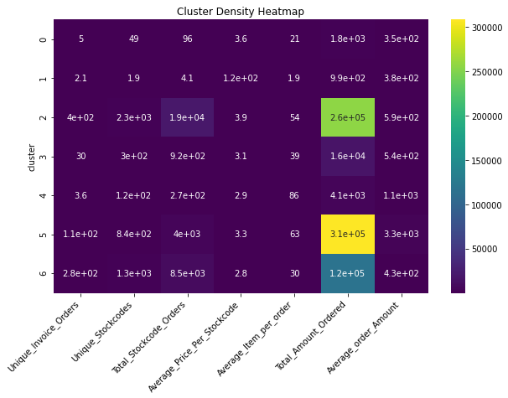
Analysis and Results
Results
After selecting our K-value of 7, we can visualize the distribution of our normalized data by cluster.
The cluster density heatmap demonstrates another point of view of our distribution by visualizing the density of each normalized metric by cluster.

Slide 21
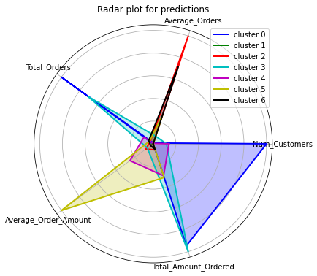
Analysis and Results
Results
With a better understanding of our data we begin to do our segmentation analysis.
We can take a snapshot of the characteristics of each cluster to understand its collective traits.
This chart illustrates a way we can create marketing plans and strategies based on characteristics of each individual cluster.

Slide 22
Analysis and Results
Results
Example Profile:
Cluster 0:
High Total Amount Order,
Large Number of Orders,
Large Number of Total Orders
Low Average Orders
Low Average Order Amount
This tells us that the first cluster is likely composed of a large number of frequent buyers that purchase small orders but purchased often.

Slide 23
Conclusion
Findings, Implications for business / Industry

Slide 24
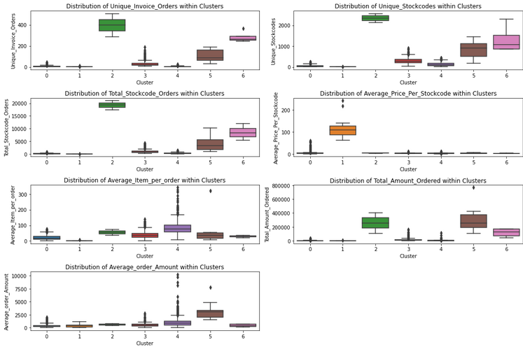
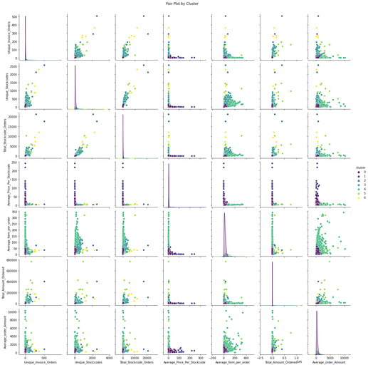
Conclusion
Findings
Our analysis showed us that we could use K-Means clustering to set up our segmentation techniques.
Bar Chart & Heatmap for Composition Analysis
Radar Chart, Box plot & Pair plot help to show the particular traits of each individual cluster, relative to one another.
These insights make it easy to create marketing strategies that lean into the traits and preferences of each cluster.

Slide 25
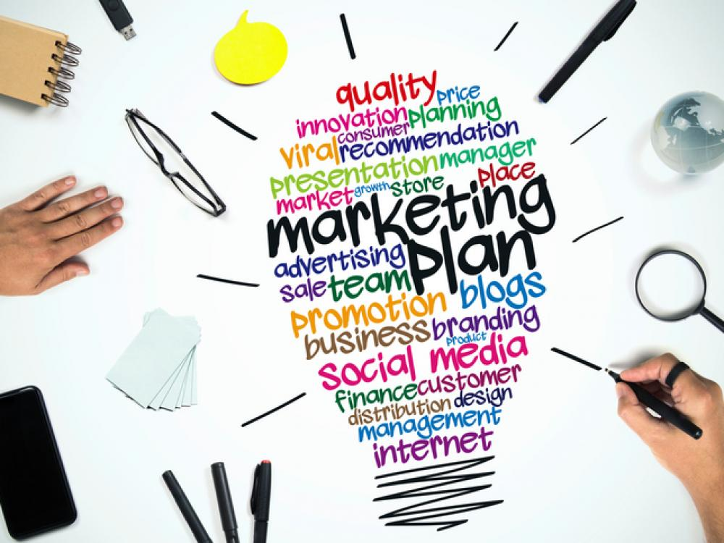
Conclusion
Findings & Impact
K-Means clustering
Grouping customers based on selected metrics involving each group’s shopping habits.
Enables grouping unnormalized features by cluster to conduct additional segmentation analysis.
Provides us with key descriptive features for each cluster that will allow us to tailor individual marketing plans for each of our seven customer segments.
Useful for curating a unique selling proposition (USP)

Slide 26
Conclusion
Research Implications:
Our experiments can provide a foundation for future efforts around K-Means for Segmentation Analysis
This provided a means of extracting insights by cluster, and for certain columns, the ability to perform additional NLP text-based analysis by cluster.
Example: Extract the individual products and expand the line of products marketed to a customer based on the other tokenized products

Slide 27
Conclusion and Recommendations
Business/Industry Relevance:
Online Retailers (Sephora, Target, Walmart, Best Buy etc.)
Digital marketers (Social media, Salesforce, Google Analytics etc)
Marketing analysis/Data analysts
Value to business/industry:
Accurately identify and focus on their most promising opportunities in the market
Leverage existing market, especially during the expansion phase
Time and cost savings compared to conventional descriptive segmentation studies (Demographics, Sex, Age etc.)

Slide 28
Q&A

